Slide 1
Project Report
Andrew Balfour, Emmanuel Obi, Samuel Casey

Slide 2
Our Goal
To provide our customers with a functional ecommerce website where he/she can learn about, shop, and purchase products on our website.

Slide 3
Technology
Html/CSS and JavaScript will be used to develop the front-end side of things
Back-end SQLite, Flask, Python
Tables: A product/inventory table that lists all the products and the number of stocks for the product and its corresponding information; A User/Customer table that will store the customer information and the product history of said customer; An Address table that stores the user’s address information for billing/shipping; An Orders table that lists the customer’s order information as well as the confirmation number for the order; An Order Contents table which contains the products and quantities of the products that have been ordered; A Cart table which stores the items a customer adds to the shopping cart.

Slide 4
Challenges
For the project, we ran into a few challenges with our site. First, the website seems to format differently on specific browsers.

Slide 5
Improvements
We would like to add the ability to have users rate our products in the store page, and for these ratings to be dynamically displayed for each product.
We’d like to improve on the emails that are sent to the customers. We’d like to add the actual products the customer purchased in the email itself that is sent out.

Slide 6

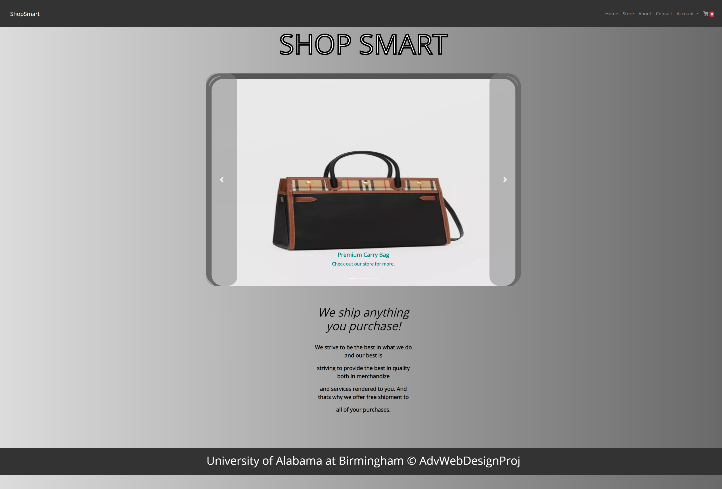
Home Page

Slide 7
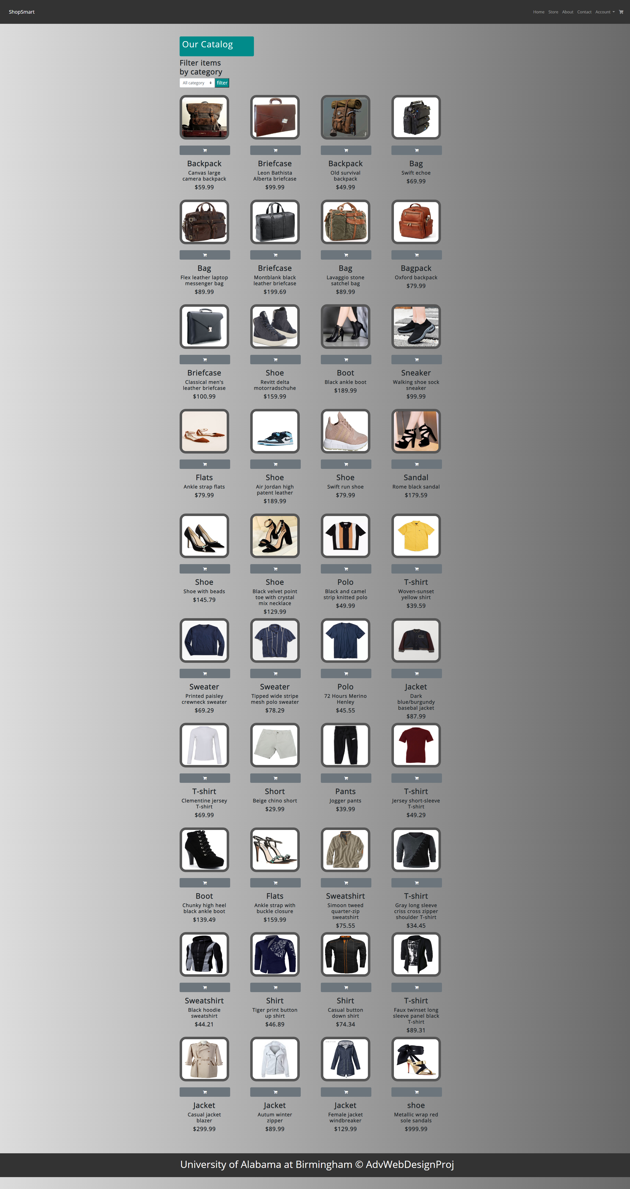
Store

Slide 8
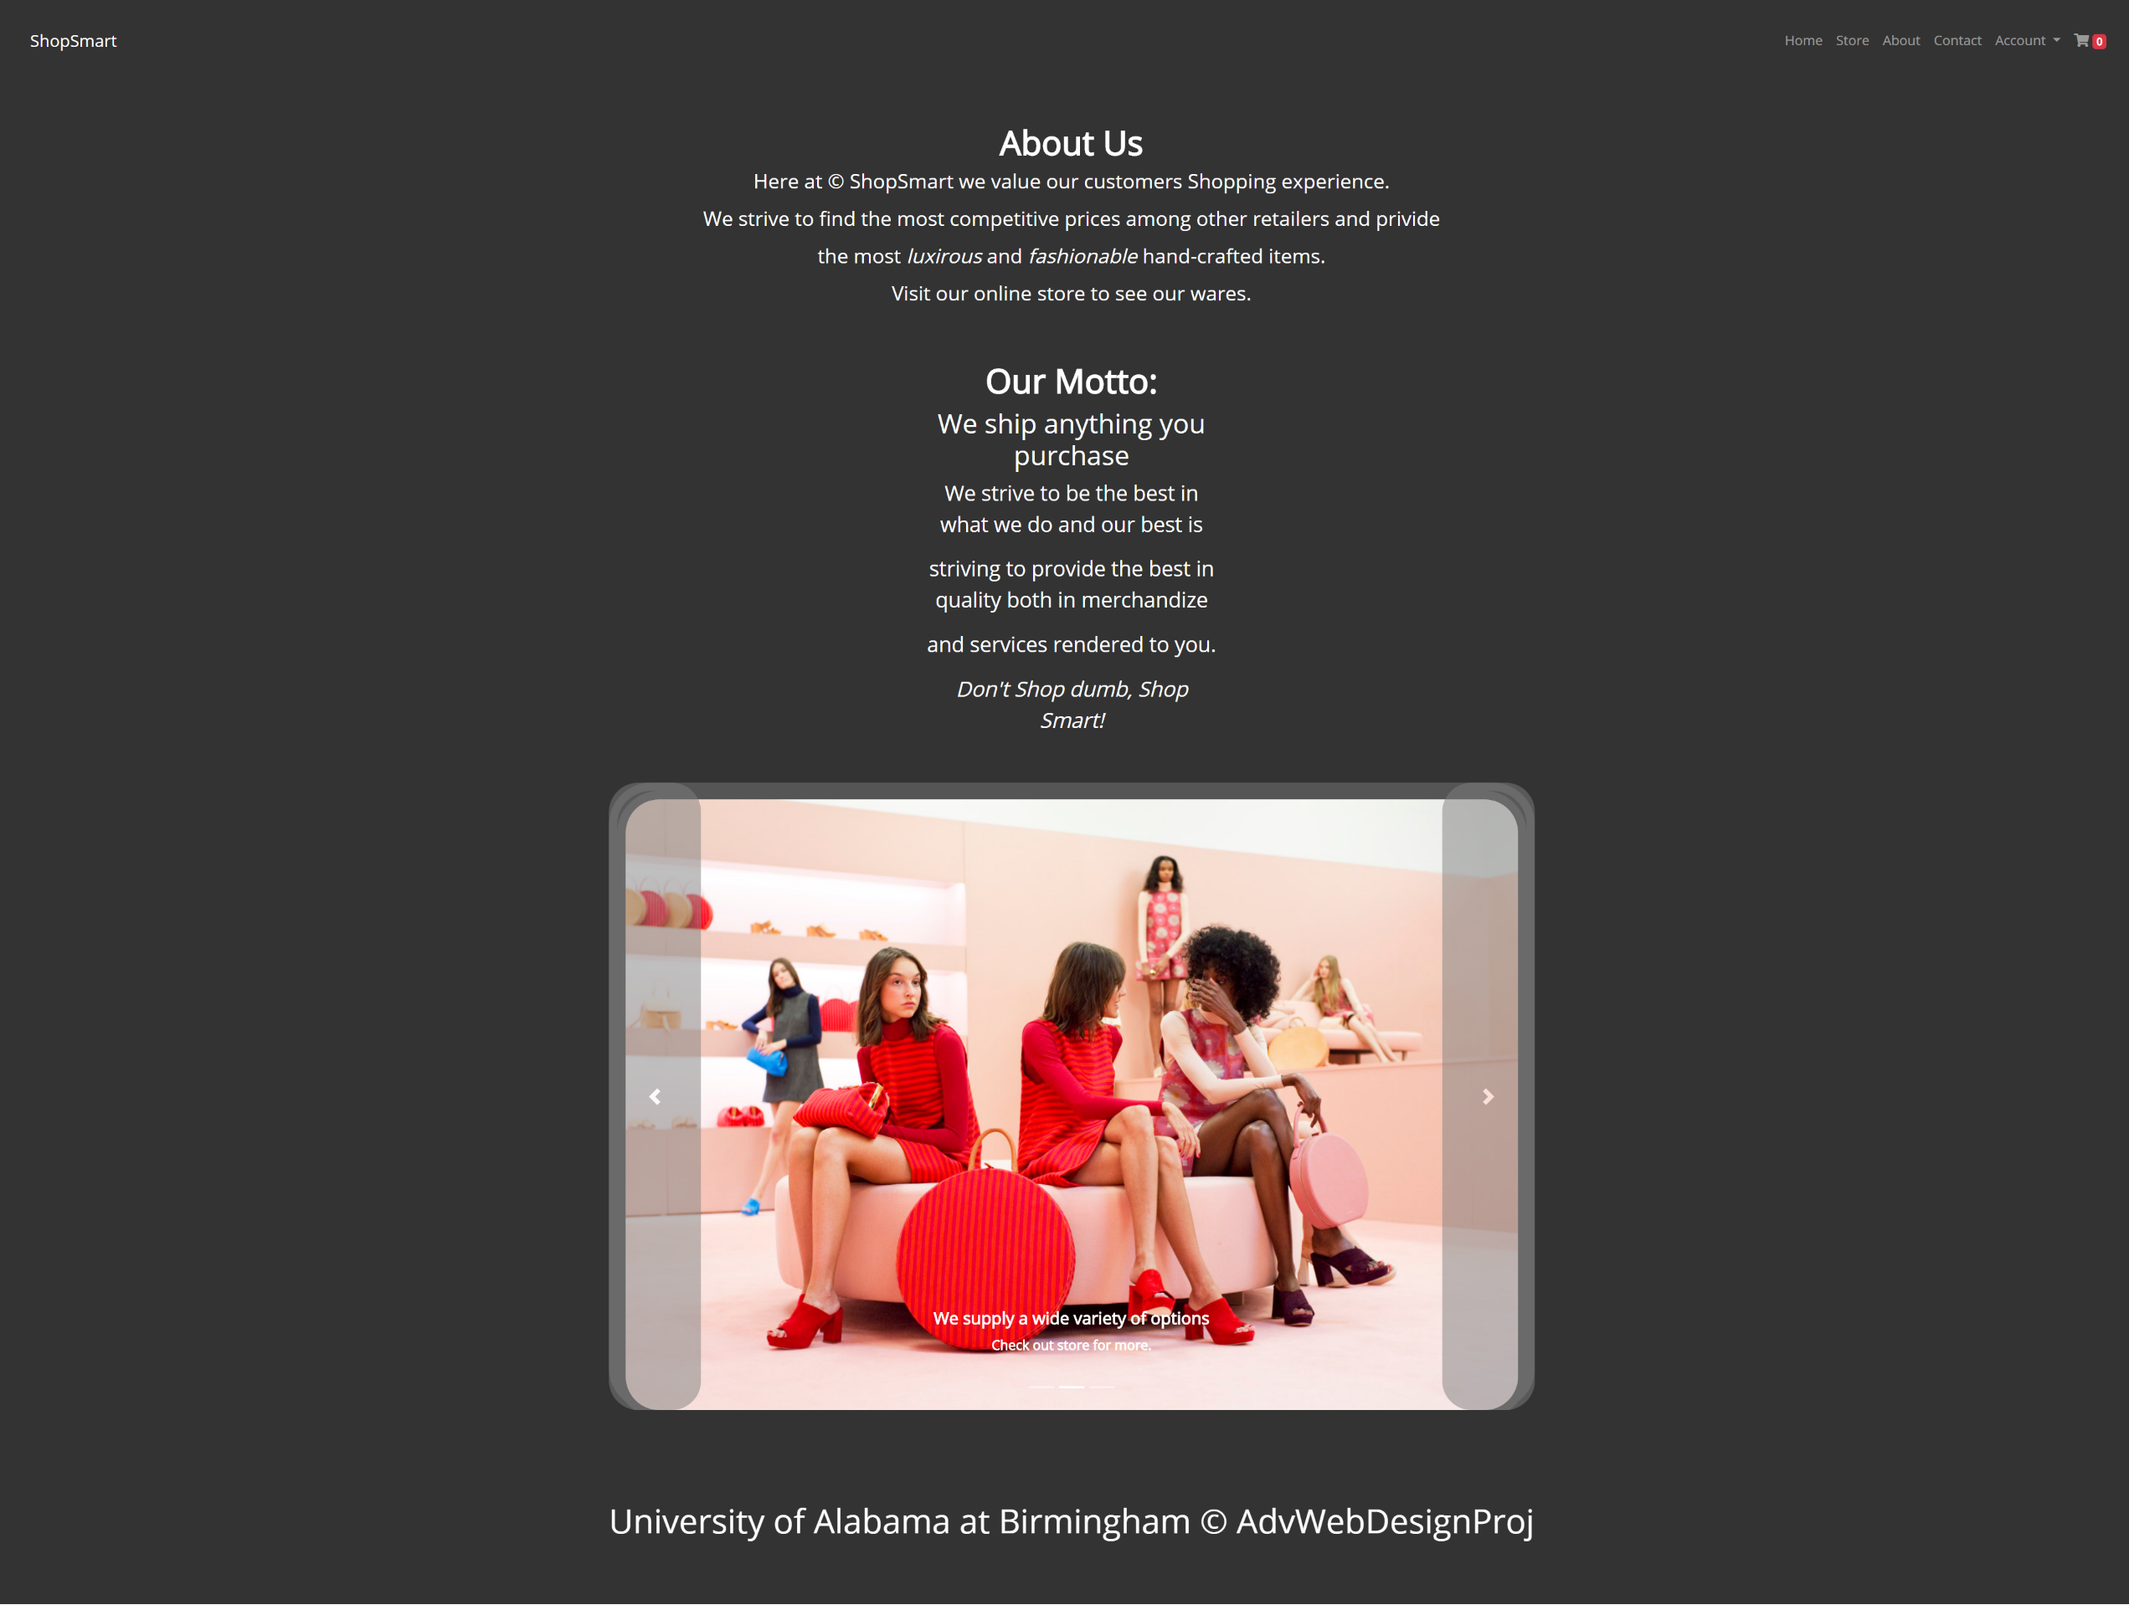
About

Slide 9
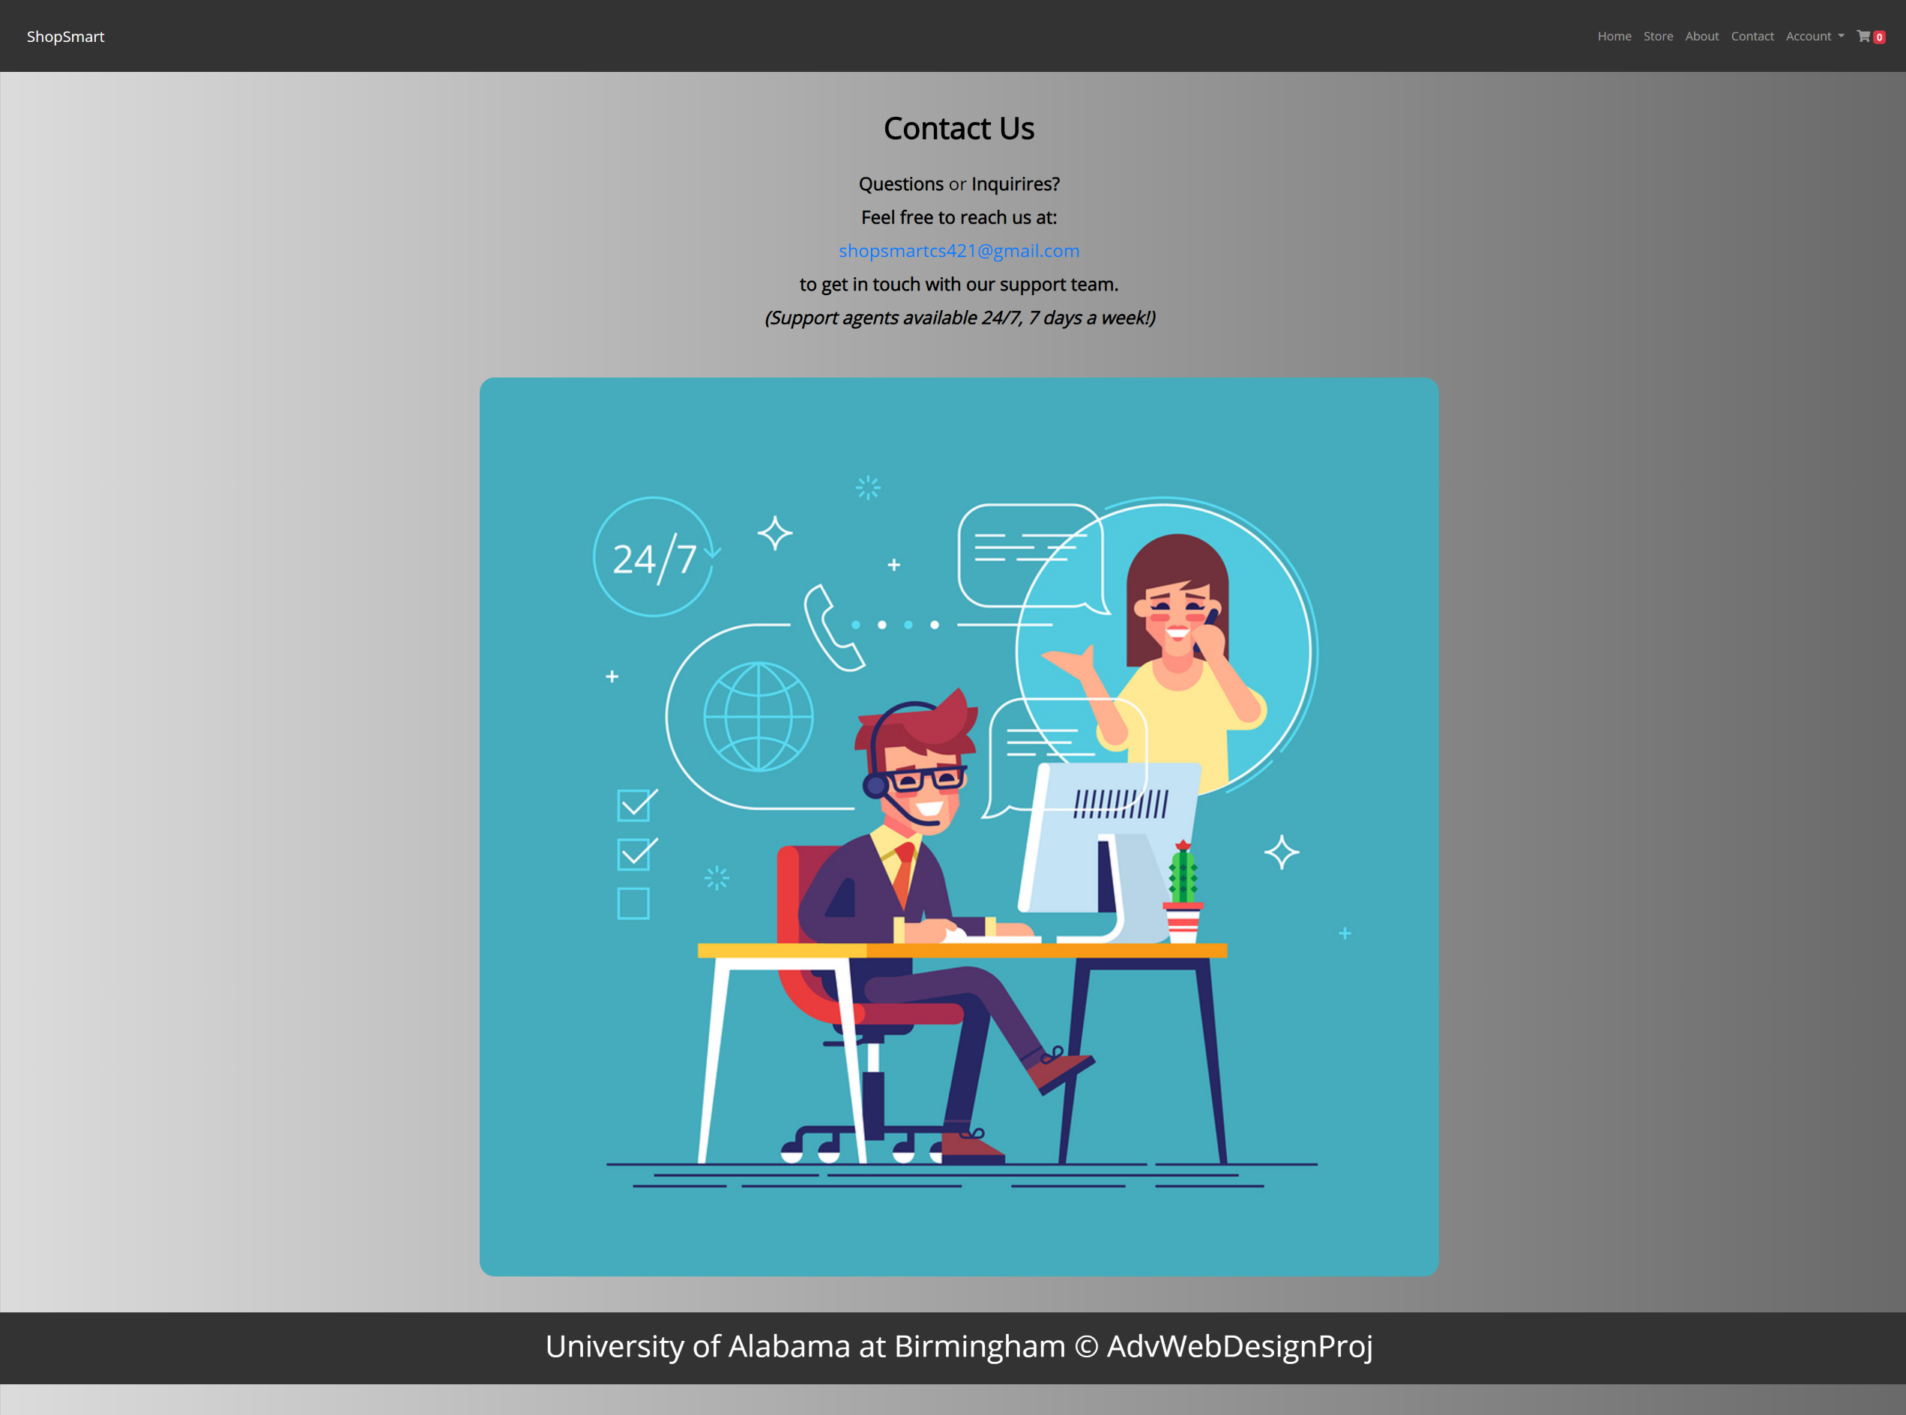
Contact

Slide 10
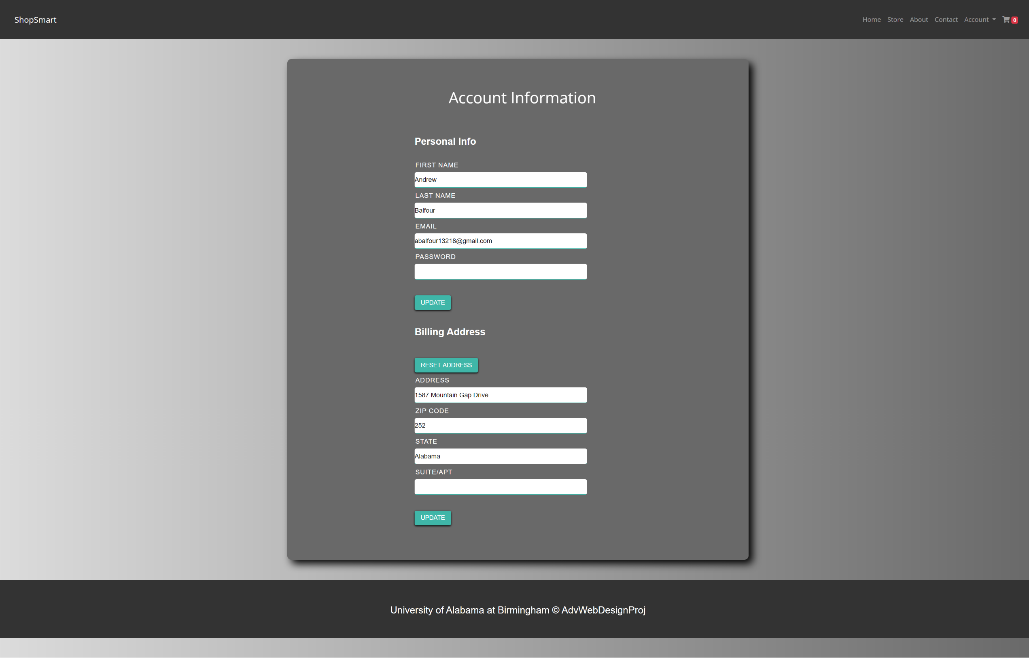
Account

Slide 11
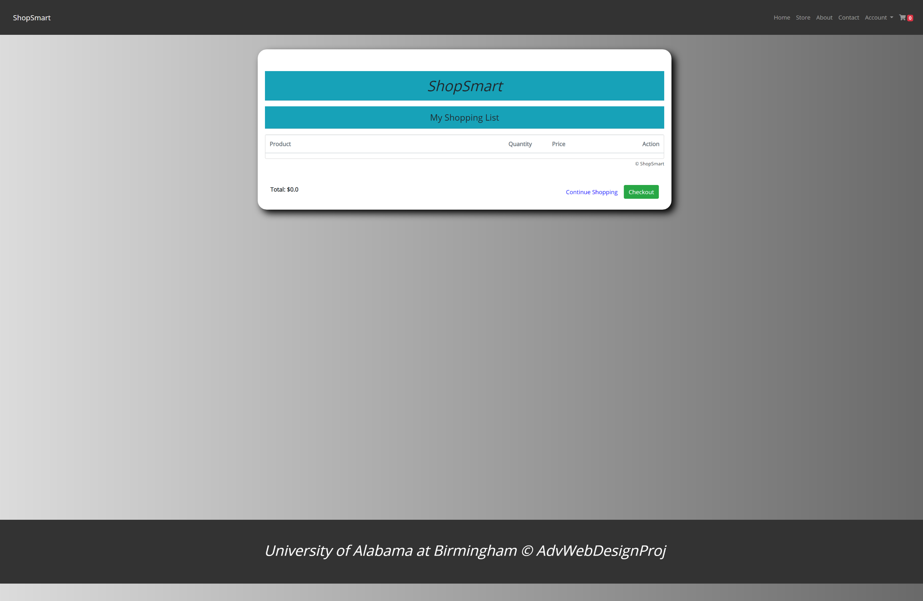
Cart

Slide 12
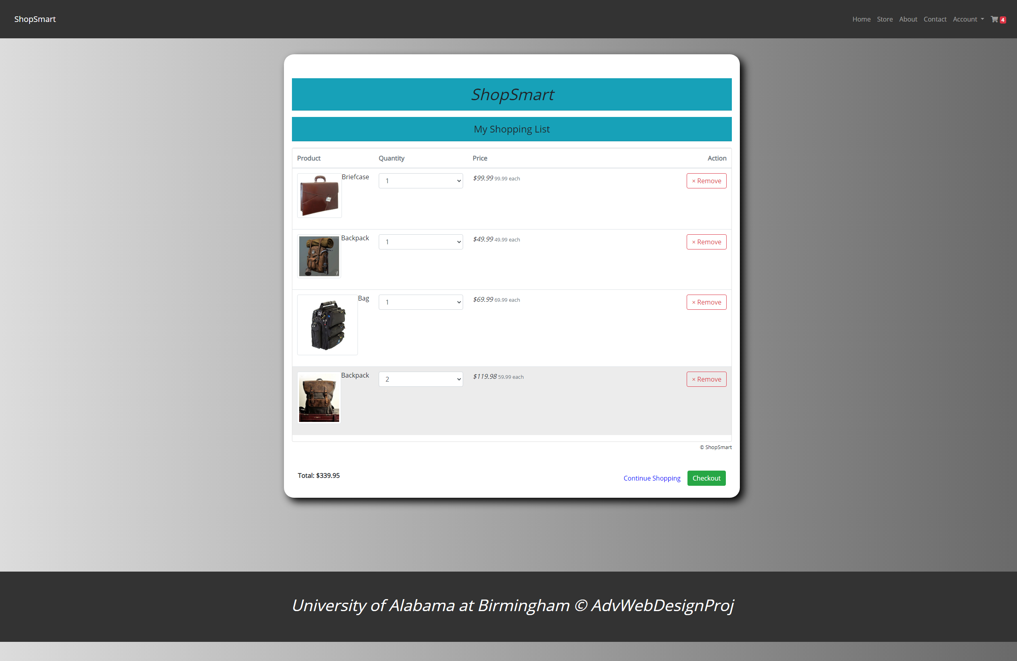
Cart filled

Slide 13
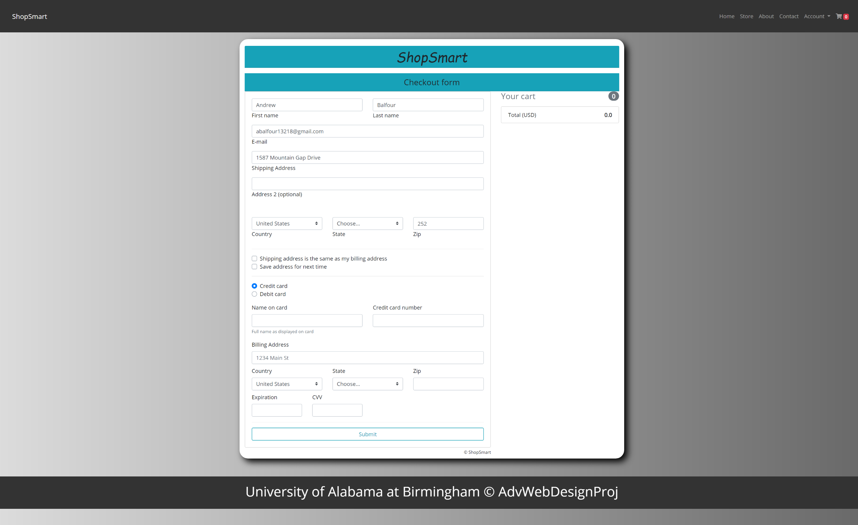
Checkout

Slide 14
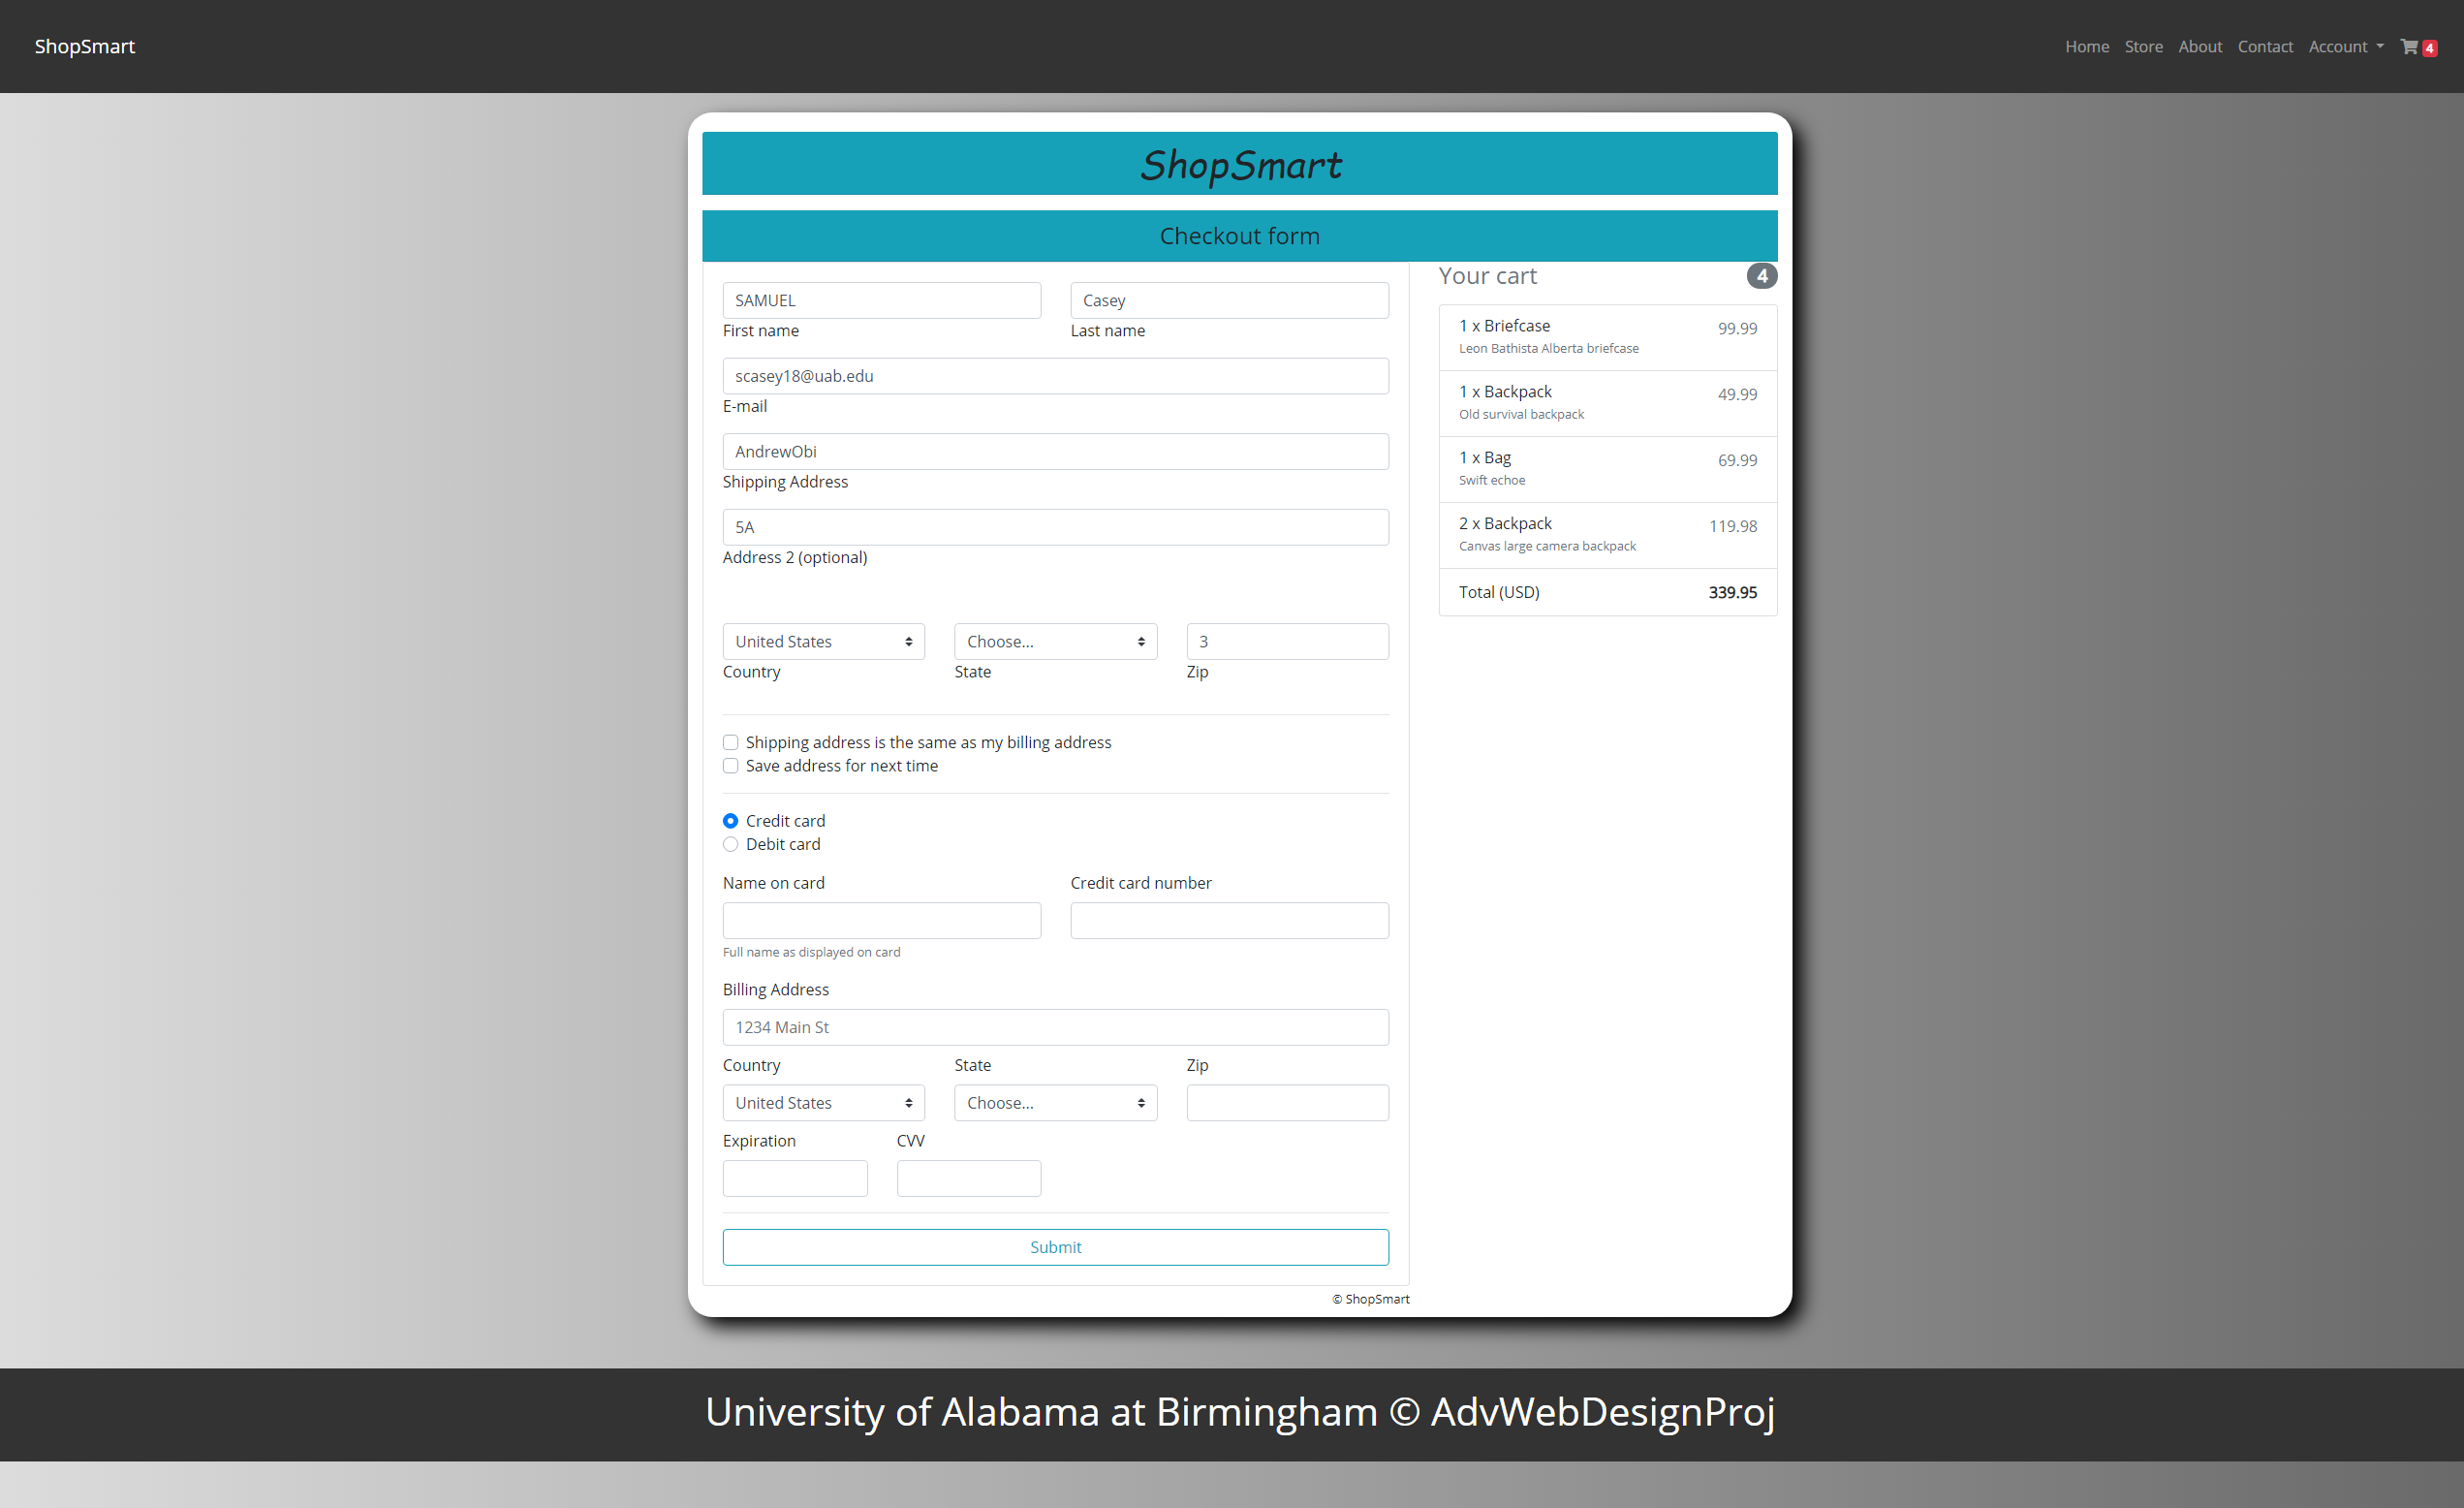
Checkout filled

Slide 15
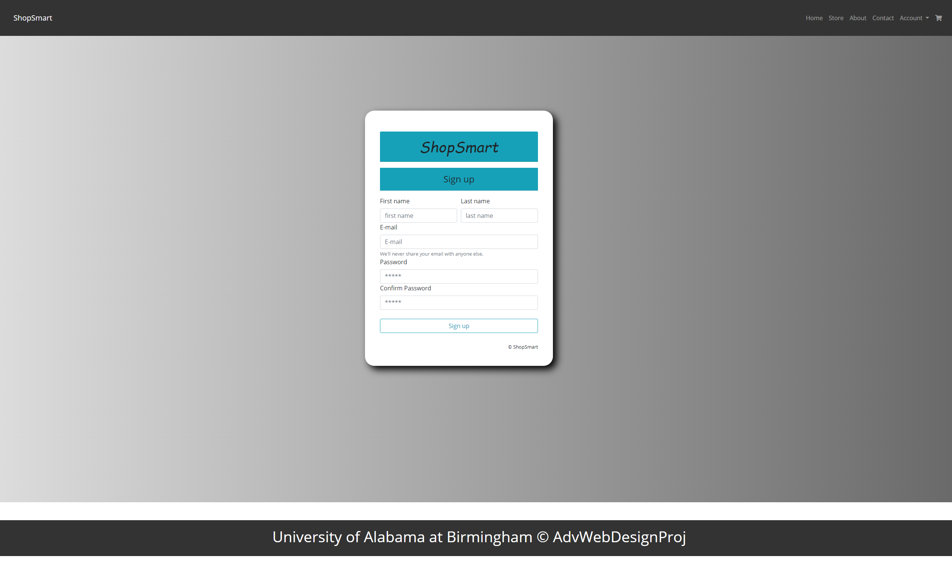
Signup

Slide 16
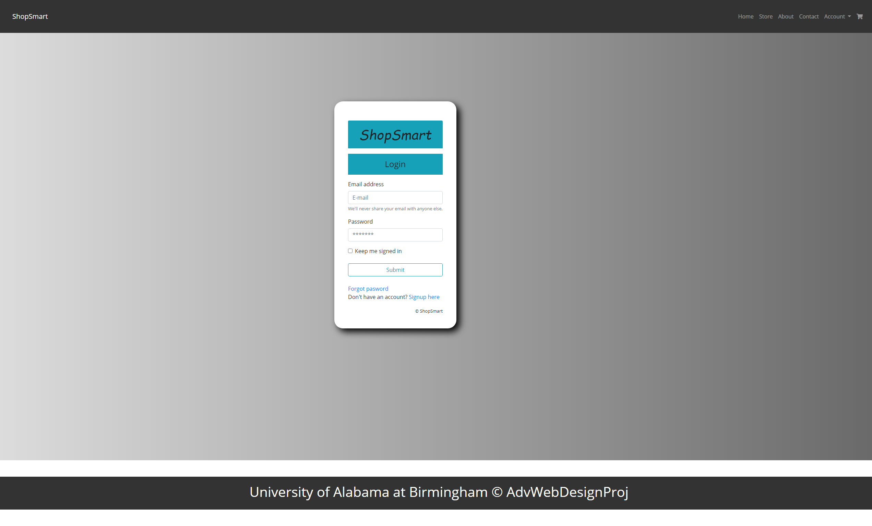
login

Slide 17
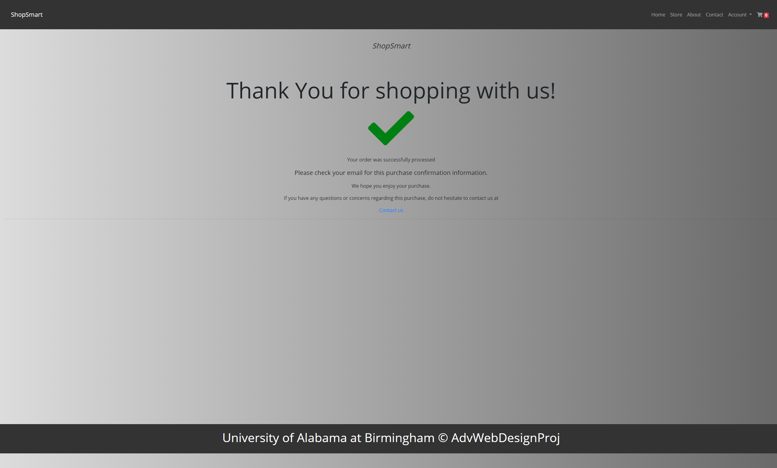
Thank You

Slide 18
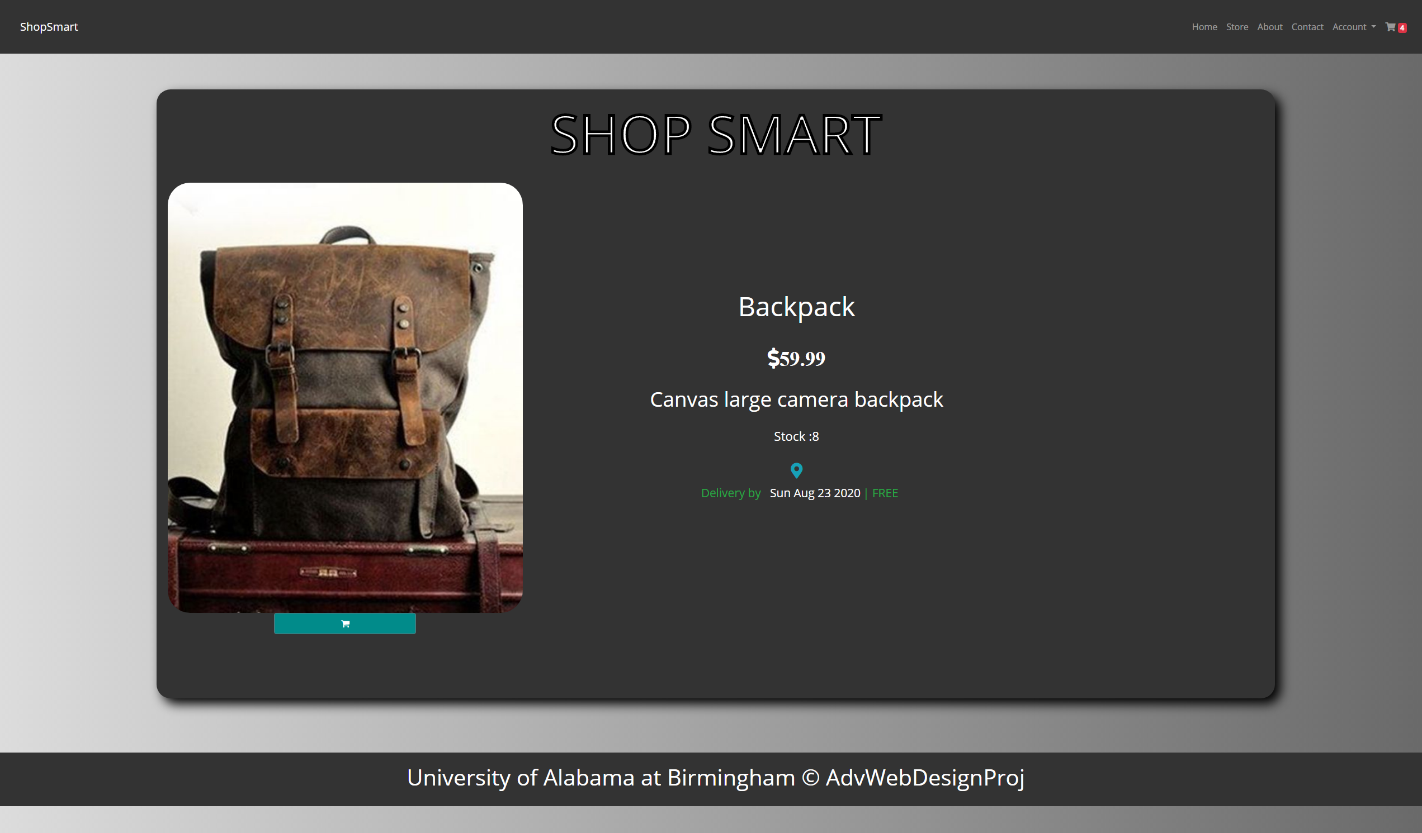
Product

Slide 19
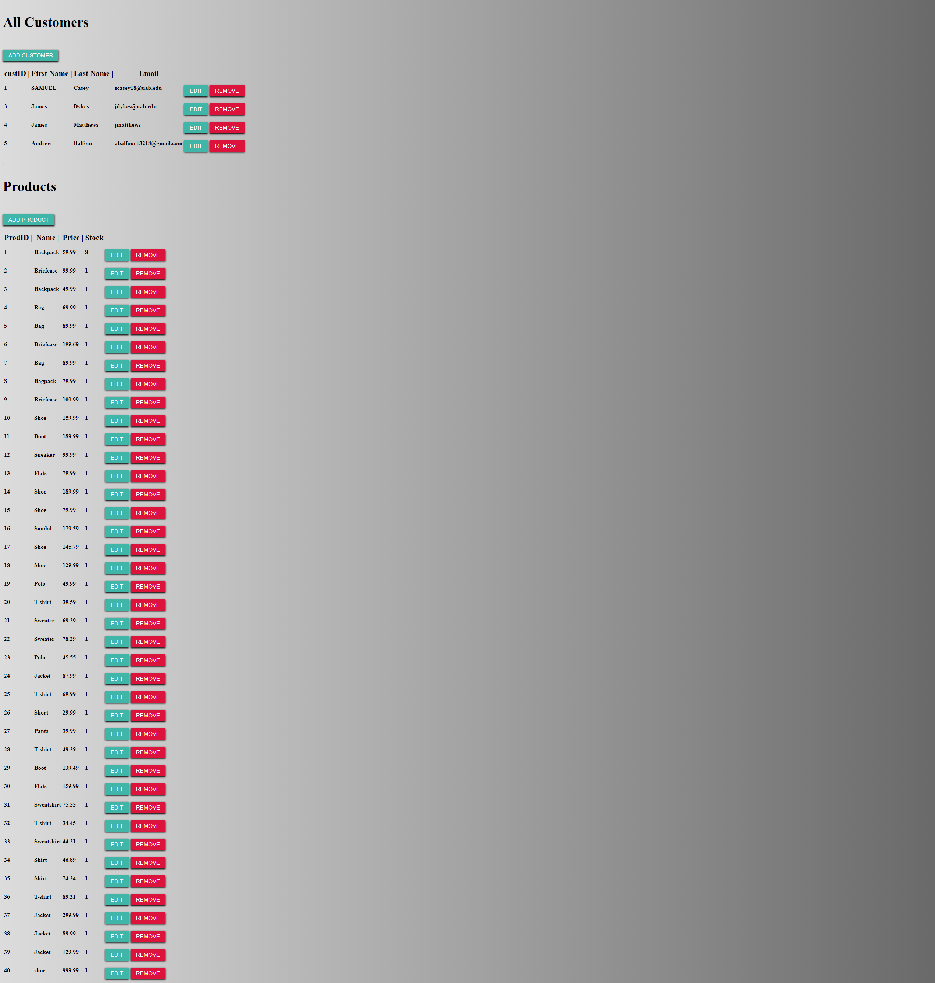
Admin

